Slide 1
CSE-4301 Object Oriented Programming 2022-2023 Week-8-9 Inheritance
-Faisal Hussain
Lecturer, Department Of Computer Science And Engineering, IUT

Slide 2
Contents
Accessing member using pointer to object
Virtual Function
Virtual destructor
Virtual Base class
Friend Function
Friend Class
Assignment and Copy Initialization
The this pointer
Dynamic cast

Slide 3
Accessing member data of object using pointer
Base class pointer can point to base class object
Derived class pointer can point to derived class object
Base class pointer can point to derived class object (Derived from the mentioned base class)
The rule is that pointers to objects of a derived class are
type compatible with pointers to objects of the base class
Derive class pointer can not point to base class object

Slide 4
Virtual Function
A virtual function is a function whose behavior can be overridden within an inheriting class by a function with the same signature.
How to declare a virtual function?
How to override a virtual function?
Virtual function implements: “One interface multiple Methods”

Slide 5
Virtual Function : Polymorphism
Virtual function supports run time polymorphism –when a virtual function is called through a pointer.
Base class pointer point -> derived objects, that contains a virtual function and the function is called through that pointer:
C++ compiler determine which version of that function will be executed based upon the type of object being pointed by the pointer
Check the Sample Example

Slide 6
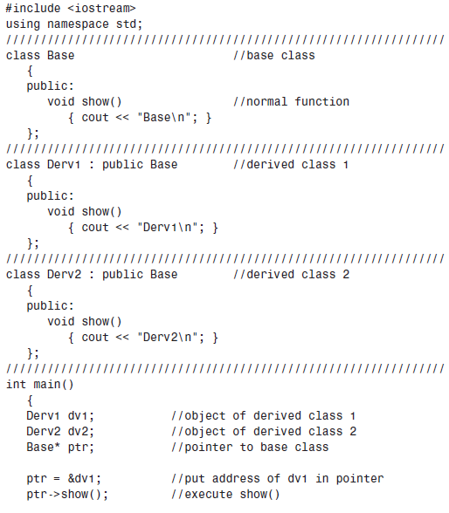
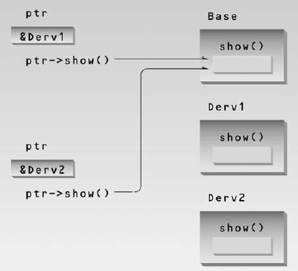

Non Virtual Pointer Access

Slide 7
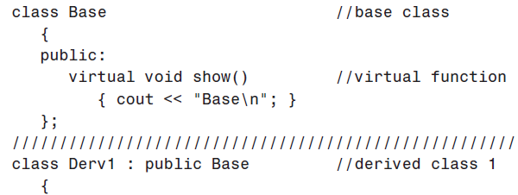
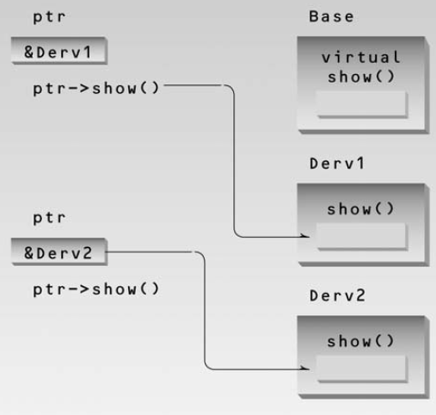
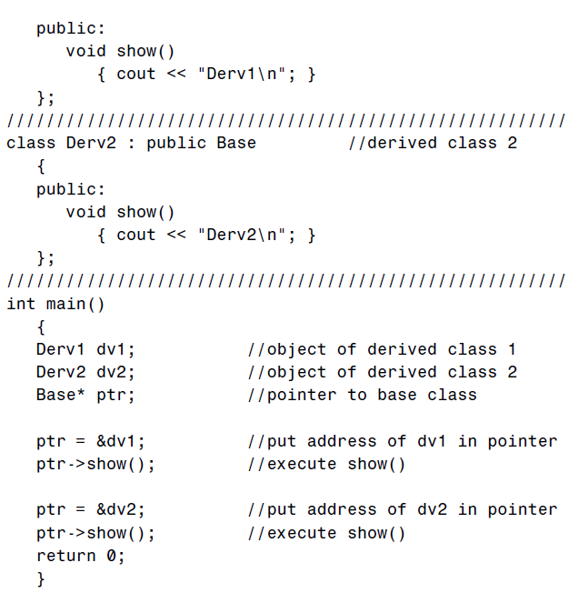
Virtual function
Late Binding/
Dynamic Binding

Slide 8
Virtual Function
When does a derived class not override a virtual function?
Virtual functions are hierarchical.
Check the Sample Example 1,2

Slide 9
Why use Virtual Function ?
when you want to override a certain behavior for your derived class than the one implemented for the Base class.
And
want to do so at run-time through a pointer to Base class.

Slide 10
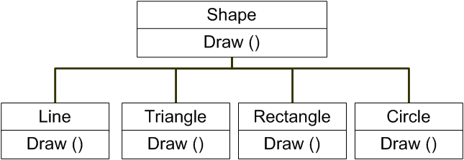
Why use Virtual Function ?
Check the Sample Example 3

Slide 11
pure virtual function
A pure virtual function has no difference with virtual function except:
Only functions prototype is included (no body)
Derived class Must override this function
How to declare a pure virtual function?
Check the Sample Example 4

Slide 12
Abstract Classes :
Abstract Classes :
containing pure virtual methods/functions are termed "abstract" and they cannot be instantiated directly.
A subclass of an abstract class can only be instantiated directly if all inherited pure virtual methods have been implemented by that class or a parent class.

Slide 13
Reading Assignment
Multiple Inheritance
Virtual member function and Virtual base class
Working with array of Objects (Finding most attractive object )
Passing object as argument to any function defined outside of the class.
Passing array of Object as argument
Pointer of an object & How to handle those.

Slide 14
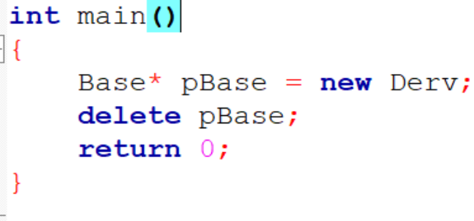
Virtual Destructor
If non virtual destructor is present in Base class then delete of Base class pointer triggers only Base class destructor.
If Base class destructor is a virtual function and Base class pointer is pointing a Derived class object then delete of Base class pointer triggers the Derv class destructor then Base class destructor.
Check the sample code 5

Slide 15
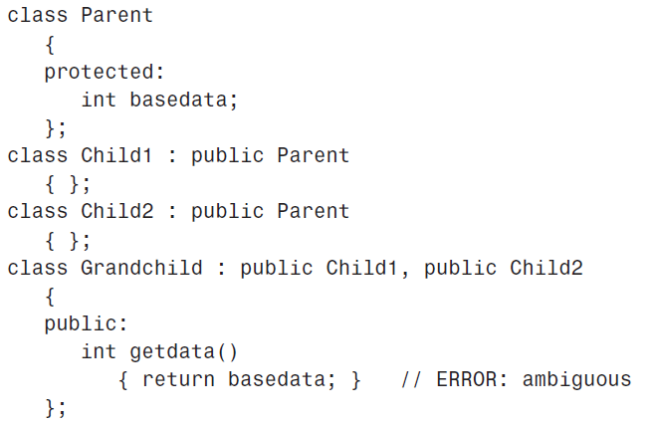
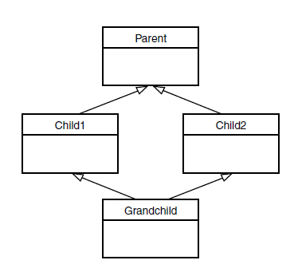
Virtual Base Class

Slide 16
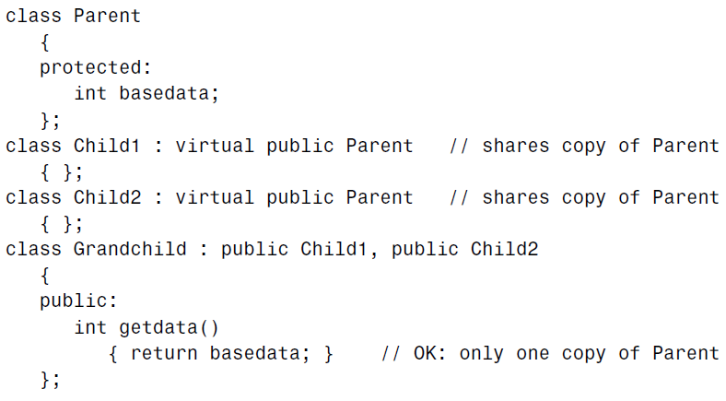
Virtual Base Class
Virtual base classes, used in virtual inheritance, is a way of preventing multiple "instances" of a given class appearing in an inheritance hierarchy when using multiple inheritance
Check the Sample Example 6

Slide 17
Friend Functions
Non-member functions should not be able to access an object’s private or protected data
a function to operate on objects of two different classes
Check the sample code 4
A programmer who does not have access to the source code for the class cannot make a function into a friend
If many friends functions are needed, you may need to rethink the design of the program.
Check the Sample Example 7,8,9

Slide 18
Friend Class
The member functions of a class can all be made friends at the same time when you make the entire class a friend.
Check the sample code 10

Slide 19
The this pointer
The member functions of every object have access to a special pointer named this which points to the object itself.
Check the sample code 11

Slide 20
RTTI (Run-time type Information)
RTTI (Run-time type information) is a mechanism that exposes information about an object’s data type at runtime and is available only for the classes which have at least one virtual function.
The RTTI is available only when there is a polymorphic behaviour

Slide 21
dynamic_cast
#include <typeinfo> for dynamic_cast
Base class pointer may hold different derived class pointer (that inherits the same base class), how to check a certain derive class pointer or not.
Check sample code 7
Check typeid operator

